Slide 1
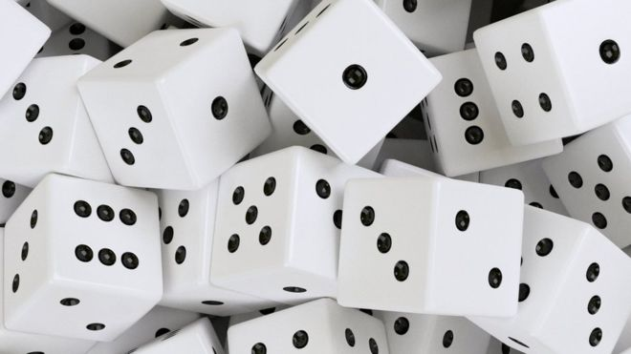
DBMS_RANDOM
Michal Kvet
Advanced database systems
Notes:
Interval.sql

Slide 2
DBMS_RANDOM pacKage
built-in random generator
not intended for cryptography
DBMS_RANDOM can be explicitly initialized, but does not need to be initialized before calling the random number generator. It will automatically initialize with the date, userid, and process id if no explicit initialization is performed.
If this package is seeded twice with the same seed, then accessed in the same way, it will produce the same results in both cases.

Slide 3
Methods
INITIALIZE Procedure Initializes the package with a seed value
NORMAL Function Returns random numbers in a normal distribution
RANDOM Procedure Generates a random number
SEED Procedures Resets the seed
STRING Function Gets a random string
TERMINATE Procedure Terminates package
VALUE Functions This function gets a random number, greater
than or equal to 0 and less than 1, with 38 digits
to the right of the decimal (38digit precision),
while the overloaded function gets a random
Oracle number x, where x is greater than or
equal to low and less than high

Slide 4
Initialize
This procedure initializes the generator (obsolete – calls SEED procedure).
DBMS_RANDOM.INITIALIZE (val IN BINARY_INTEGER);

Slide 5
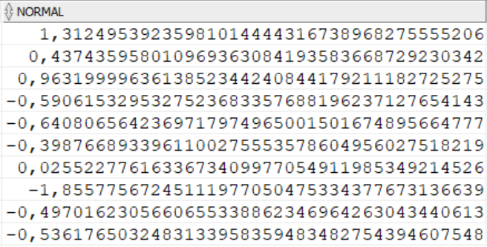
Normal
This function returns random numbers in a standard normal distribution.
DBMS_RANDOM.NORMAL RETURN NUMBER;

Slide 6
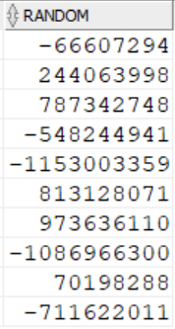
RANDOM
This procedure generates a random number.
DBMS_RANDOM.RANDOM RETURN binary_integer;
Returns a random integer greater or equal to -power(2,31)
and less than power(2,31).

Slide 7
Seed
This procedure resets the seed.
DBMS_RANDOM.SEED (seed IN BINARY_INTEGER); DBMS_RANDOM.SEED (seed IN VARCHAR2);
The seed can be a string up to length 2000.

Slide 8
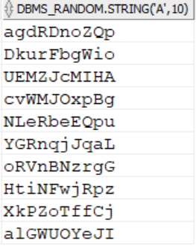
STRING
This function gets a random string.
DBMS_RANDOM.STRING (opt IN CHAR, len IN NUMBER)
RETURN VARCHAR2;
opt:
'u', 'U' returning string in uppercase alpha characters
'l', 'L' returning string in lowercase alpha characters
'a', 'A' returning string in mixed case alpha characters
'x', 'X' returning string in uppercase alphanumeric characters
'p', 'P' returning string in any printable characters.

Slide 9
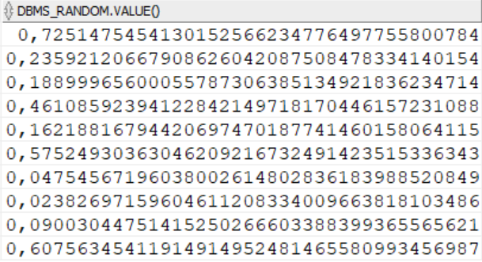
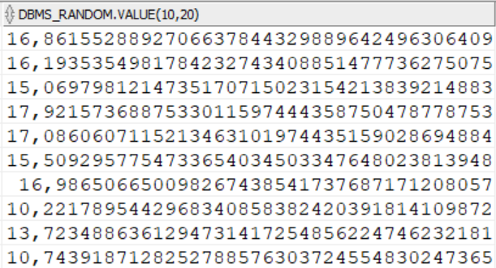
VALUE
The basic function gets a random number, greater than or equal to 0 and less than 1, with 38 digits to the right of the decimal (38digit precision).
Alternatively, you can get a random Oracle number x, where x is greater than or equal to low and less than high.
DBMS_RANDOM.VALUE RETURN NUMBER;
DBMS_RANDOM.VALUE(low IN NUMBER, high IN NUMBER) RETURN NUMBER;

Slide 10
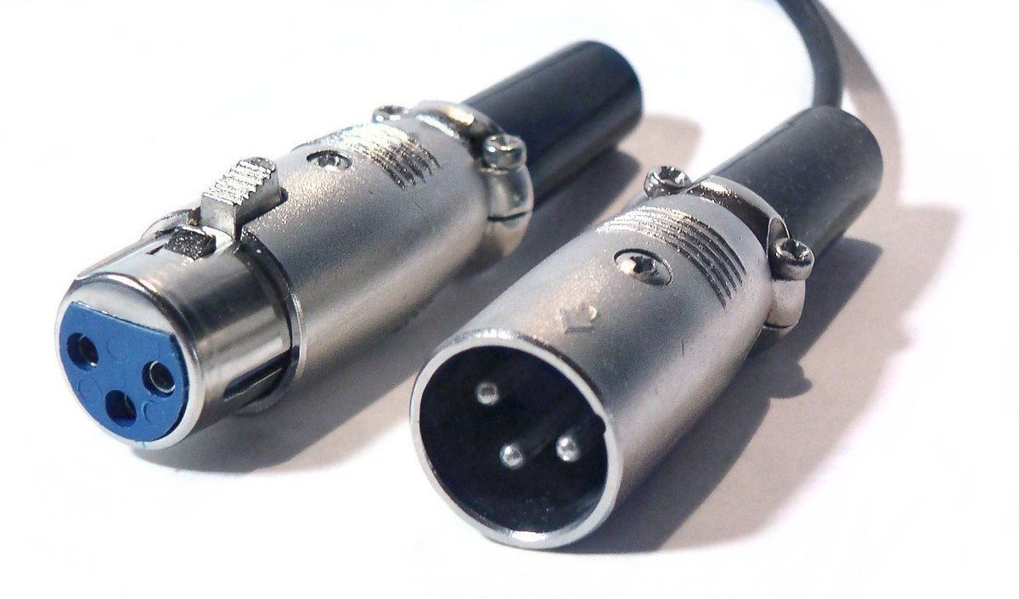
CONNECT BY LEVEL
Michal Kvet
Advanced database systems
Notes:
Interval.sql

Slide 11
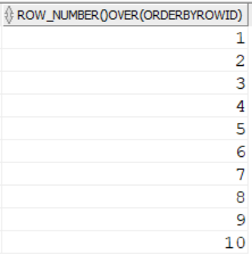
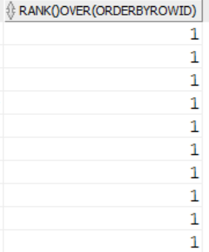
CONNECT BY LEVEL
select DBMS_RANDOM.value(10,20)
from dual
connect by level <11;
select row_number() over(order by rowid)
from dual
connect by level <11;
select rank() over(order by rowid)
from dual
connect by level <11;

Slide 12

DEFERRABLE CONSTRAINTS
Michal Kvet
Advanced database systems
Notes:
Interval.sql

Slide 13
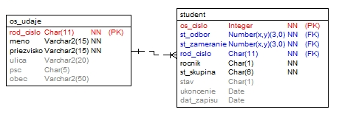
Deferrable constraints

Slide 14
Deferrable constraints
Impossible…
reference in os_udaje does not exists
Update student
set rod_cislo='841106/3458'
where rod_cislo='841106/3456';
Impossible…
reference of student row does not exists
Update os_udaje
set rod_cislo='841106/3458'
where rod_cislo='841106/3456';

Slide 15
SOLUTION
Insert into os_udaje(rod_cislo, meno, priezvisko,
ulica, pcs, obec)
(select '841106/3458', meno, priezvisko,
ulica, psc, obec
from os_udaje
where rod_cislo='841106/3456');
Update student
set rod_cislo='841106/3458'
where rod_cislo='841106/3456';
Delete from os_udaje
where rod_cislo='841106/3456';
INSERT
UPDATE
DELETE

Slide 16
SOLUTION
By using triggers…

Slide 17
SOLUTION - Deferrable constraints
Alter table student
add (constraint st_os_fk
foreign key(rod_cislo)
references os_udaje deferrable);
Alter session set constraints=deferred;
DEFERRABLE
Alter table student
add (constraint st_os_fk
foreign key(rod_cislo)
references os_udaje initially immediate);
Alter session set constraints=immediate;
IMMEDIATE

Slide 18

Thank you for your attention

